Slide 1
POSA
Stephen Riley, MSE ’07
Sr. Dir. Engineering
Apptio

Slide 2
J. Stephen Riley, MSE ‘07

Slide 3
Agenda
Review of design patterns
Overview of architectural patterns
High level patterns in detail

Slide 4
Design Patterns Review

Slide 5
What is a pattern
Describes a problem which occurs over and over again
Describes a solution to that problem
Can be applied millions of times, each time in a different way
…descriptions of communicating objects and classes that are customized to solve a general design problem in a particular context

Slide 6
How design patterns solve design problems
Finding appropriate objects
Determining object granularity
Specifying object interfaces
Specifying object implementations
Remind yourself what tools are available

Slide 7
Levels of patterns
Idioms
Design patterns
Architectural patterns

Slide 8
Levels – idioms
The expression of a special feature of a recurring construct in one or more programming languages
Often confused with (and mixed with!) coding standards
string result = value1 ?? value2 ?? value3 ?? String.Empty;

Slide 9
Levels – design patterns
General, reusable solutions to commonly occurring problems within a given context in software design
Formalized best practices that the programmer can use to solve common problems when designing an application or system
Singleton: ensure a class has only one instance, and provide a global point of access to it.

Slide 10
Architectural Patterns
The 60,000 foot view

Slide 11
So what is “architecture”?
The high level structures of a software system
Everything that is not related to the business logic/domain of the system
Eg. the arrangement of AWS resources is architecture, but how the code processes business objects is not

Slide 12
Levels – architectural patterns
Similar to design patterns, but…
Address various issues in software engineering, such as computer hardware performance limitations, high availability (HA), and minimization of a business risk
Pipes and filters: a pipeline consisting of a chain of processing elements, arranged so that the output of each element is the input of the next

Slide 13
Why use architectural patterns?
Communication shortcut
Don’t reinvent the wheel
Standardized implementations
Only so many [efficient] ways to solve non-domain problems.

Slide 14
Arch patterns and frameworks
Arch patterns (high level) are often 1:1 with frameworks for broad domains
Examples:
ASP.NET (Layers)
Apache Camel (Pipes & Filters)
Smalltalk UI (MVC)
JavaSpaces (Blackboard)
Erlang OTP (Actors)
Notes:
But note that GoF talks about “frameworks” here to mean domain-specific frameworks, not general frameworks. So, graphical editor framework, spreadsheet framework, simulation framework are good examples. Generic libraries (.Net BCL, Java JDK, stdlib, boost) are useful for creating many classes of application. There are higher level frameworks that bridge that boundary. Think about windowing libraries, widget libraries, javascript frameworks.

Slide 15
Categories of arch patterns
From Mud to Structure Distribution Infrastructure Event Multiplexing and Dispatching Interface Partitioning Component Partitioning Application Control Concurrency | Synchronization Object Interaction Adaptation and Extension Modal Behavior Resource Management Database Access
POSA4: A Pattern Language for Distributed Computing

Slide 16
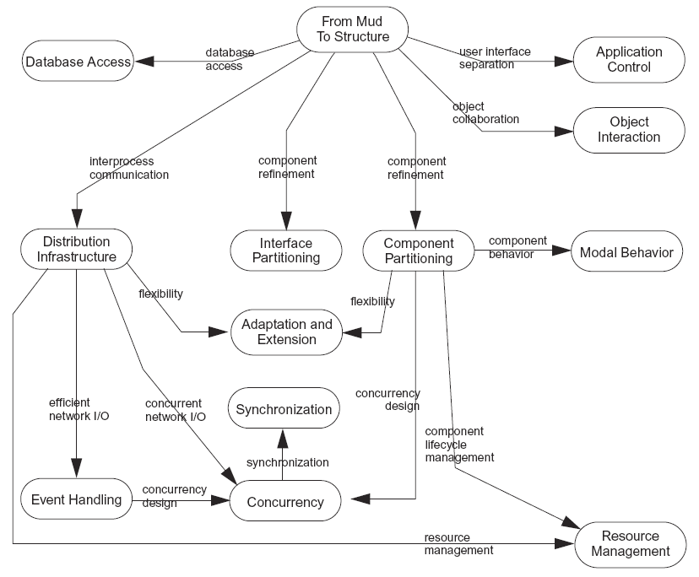
Notes:
From Mud to Structure: taking business requirements and determining a system to hang the domain logic in

Slide 17
TL;DR Our pattern language
The pattern name
Scope of the problem
Challenges
Components / related patterns
Discussion

Slide 18
Patterns to review
Layers
Pipes and filters
MVC
Pub-Sub
Microkernel
Blackboard / Tuple Spaces
Actor*
(category: From Mud to Structure)

Slide 19
Layers
Must support the independent development of different system parts
Challenge: separation of concerns
Components: Explicit Interfaces, Encapsulated Implementation, Commands/Messages, Data Transfer Objects (DTOs)
Notes:
Classic 3-tier architecture

Slide 20
Pipes & Filters
Must sometimes provide a design that is suitable for processing data streams
Challenges:
Common request/response semantics (eg. REST) don’t work for streams
Debugging
Async
Components: Domain Objects, Messages
Enterprise Integration Patterns
Notes:
Async workflows
Popularized in EIP
Can you put a web front end on? Yes!

Slide 21
Model-View-Controller
Must consider that the UI of an application changes more frequently than its domain functionality
Challenges:
Changes to UI must not affect the app’s core functionality
(When in doubt, see above)
Components:
Model (processing), Controller (input), View (output)
Domain Objects, Template View, Transform View, Page Controller, Command Processor, Data Transfer Objects (DTOs), Observer
Notes:
Classic web app
Superseded these days by MVVM in many web apps

Slide 22
Publisher-Subscriber
Often need an infrastructure that allows components to notify each other about events of interest
Challenges:
Robust notification system to coordinate state change
Asynchronous
Components:
Messaging, Broker, Event-Driven Consumers
Enterprise Integration Patterns
Notes:
Most commonly known as Pub-Sub
Think SQS, RabbitMQ

Slide 23
Microkernel
Must design support for functional scalability and adaptability (multiple versions simultaneously)
Challenges:
Data model versioning
Components:
Layers (esp. routing layer), Object Adapter
Notes:
Eg. MACH OS framework
QNX had uptimes measure in years with no reboots, despite multiple major version upgrades!

Slide 24
Blackboard
AKA “Tuple Spaces”
Must sometimes provide a design that resolves tasks for which no deterministic solution strategy is known
Challenges:
Basically codifying trial-and-error
May not understand the output!
Components:
Domain Object (maybe many!), Database Access Layer, the “Brain”
Silver Bullet Syndrome alert!
Notes:
Eg. Linda, JavaSpaces

Slide 25
Case Study
Sales tax calculator logic
Notes:
Layers
Pub-Sub
Microkernel
Blackboard

Slide 26
References
Patterns of Software Architecture (4 volumes), pub. Wiley Press
Wiley Series in Software Design Patterns
Enterprise Integration Patterns, pub. Addison Wesley
Patterns of Enterprise Application Architecture, pub. Addison Wesley
Framework Design Guidelines: Conventions, Idioms, and Patterns for Reusable .NET Libraries, pub. Addison Wesley
wiki.c2.com (Agile, patterns, etc.)

Slide 27
Appendix

Slide 28
Bonus: Actors
Must sometimes provide a highly-concurrent system where fail-fast is a design goal
Challenges:
Orthogonal to traditional concurrent design
Difficult to debug
Components:
GenServer (state management), Messages, Object Adapter
cf. Elixir, Erlang, Akka

